Slide 1
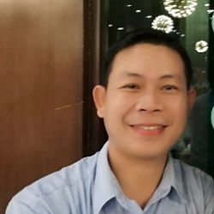
Center of Excellence in Environment
Research and Academic Service Office, National University of Laos, Lao PDR
Dr. Santi Kongmany
Director, Center of Excellence in Environment
Research and Academic Service Office, National University of Laos
s.kongmany@nuol.edu.la

Slide 2
Who are you?
Describe your organization/institution
Center of Excellence in Environment (CoEE) is a central lab at National University of Laos (NUOL).
CoEE is currently under the Research and Academic Service office (RASO) at NUOL.
What is your mission?
Develop the CoEE as the research center for environmental science, technology and technical services, green innovation and food safety with trust at national and international levels.

Slide 3
What research do you conduct?
Types of research/activities
Food safety: Pesticide residue in fruits and vegetables
Environment: Water/wastewater quality monitoring, Soil Health
Material sciences: Bioplastics, activated carbon
Renewable energy: Biodiesel
Natural products: Phytochemicals in medicinal plants.

Slide 4
How do you conduct research?
Human resources: how many people and which expertise
Currently 6 people
Chemistry (analytical chemist): 2
Chemical engineering (chemist and environmentalist): 2
Environmental sciences (biologist and chemist): 2

Slide 5
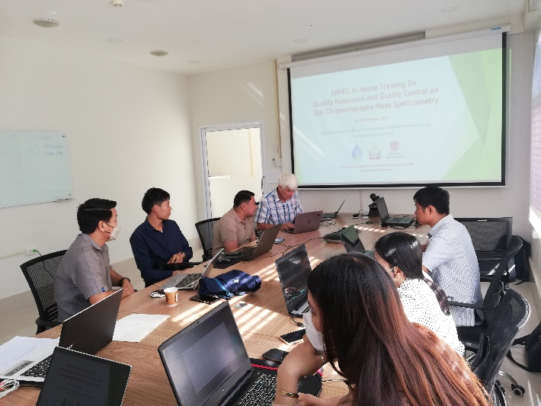
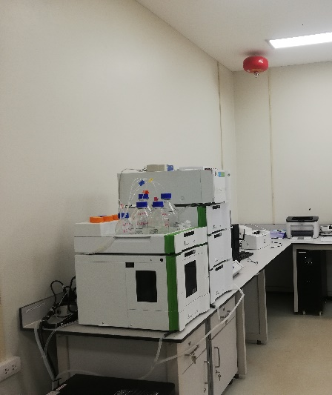
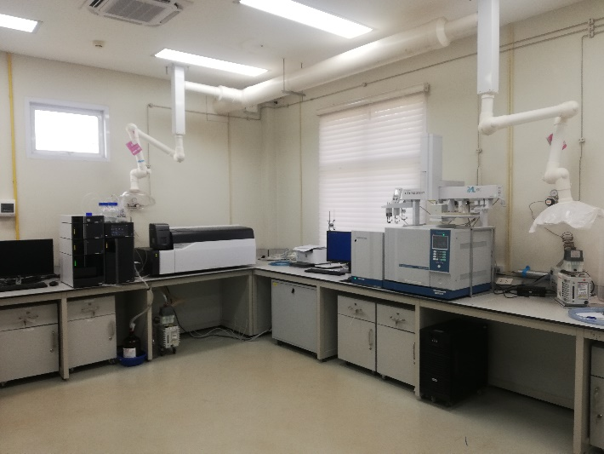
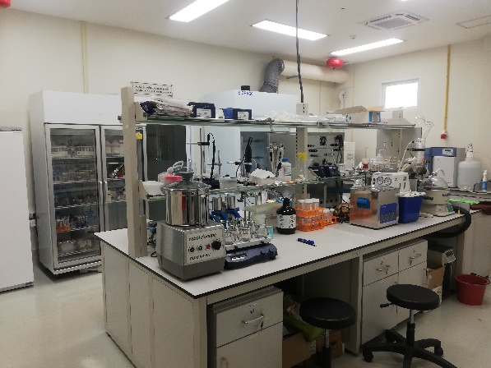
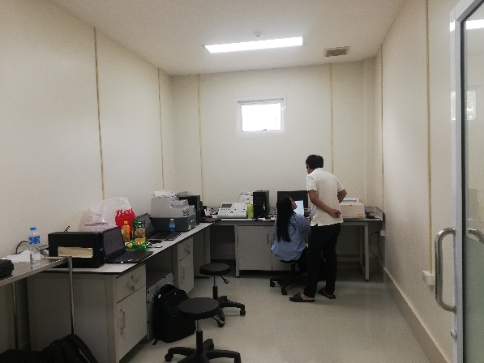
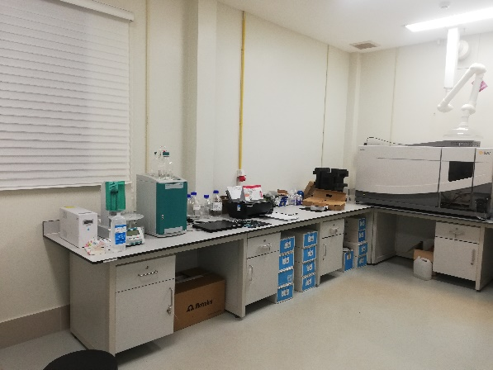
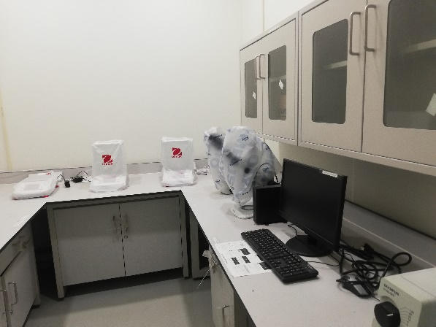
How do you conduct research?
Environment-facilities: infrastructure
1 Center building, 1 sample preparation room, 3 main rooms for analytical instruments

Slide 6
How do you conduct research?
Environment-facilities: Equipment
ICP-OES, IC, RT-PCR, FT-IR, Spectrophotometer, UHPLC/PDA/FL, GCMS-Headspace, LCMS/MS, stereo/biological/Fluorescence microscopes, Moisture analysis, analytical balances, Centrifuges, DI water production system, Autoclave, BOD analyzer, COD analyzer, hot-air oven, incubator, refrigerator, 3M Petrifilm reader Advanced.
Needed more: Freezer (-20ºC), AAS, TOC analyzer, Kjeldahl Systems (automated), CO₂ analyzer.

Slide 7
How would you like to improve your research/activities?
Forming concrete research team(s) with high professional and accountability;
Continuously improving research skills;
Networking with national and international partners.

Slide 8
What are the knowledge gaps you would like to address?
Statistic skill for data analysis.
GIST mapping skills.
Water Quality Modeling.

Slide 9
What is the most important/pressing question to address in a ONE-HEALTH research proposal ?
Environmental and health impacts of (i.e. land-use/water-use change).
Water transport of pathogens and responses of whole stream metabolism to cycles of low-flow and erosive floods.
Theoretical and practical training in environmental observation (within the framework of curricula or in-service training) relevant to the consolidation of effective OneHealth management in Laos.

